Slide 1
Rheumatoid Arthritis & spleen
A.R.Rajaei MD
arrajaei@gmail.com
Rheumatology Department
Loghman hospital

Slide 2
Key points
LGL leukemia/rheumatoid arthritis and Felty’s syndrome are part of the same disease.
LGL leukemia/rheumatoid arthritis and Felty’s syndrome share similarity in clinical presentation, immunologic, pathologic, and genetic features.
Low dose of immunosuppressive treatment is effective in both patients with LGL leukemia and Felty’s syndrome

Slide 3
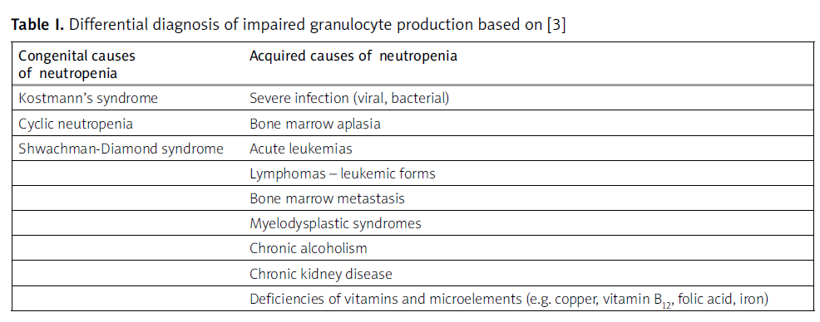

Slide 4
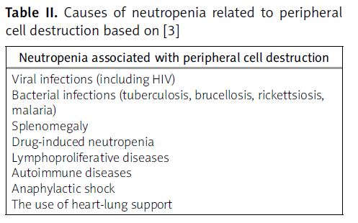

Slide 5
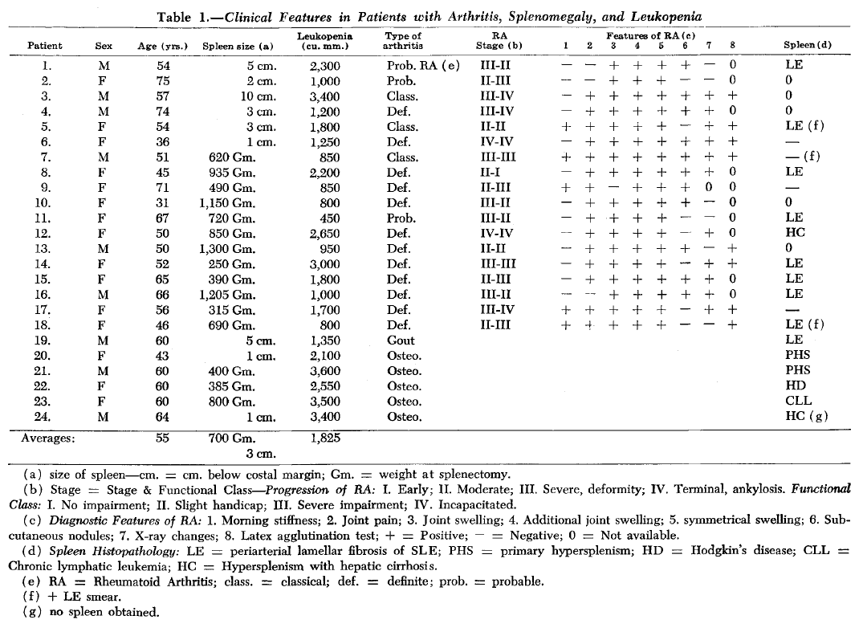

Slide 6
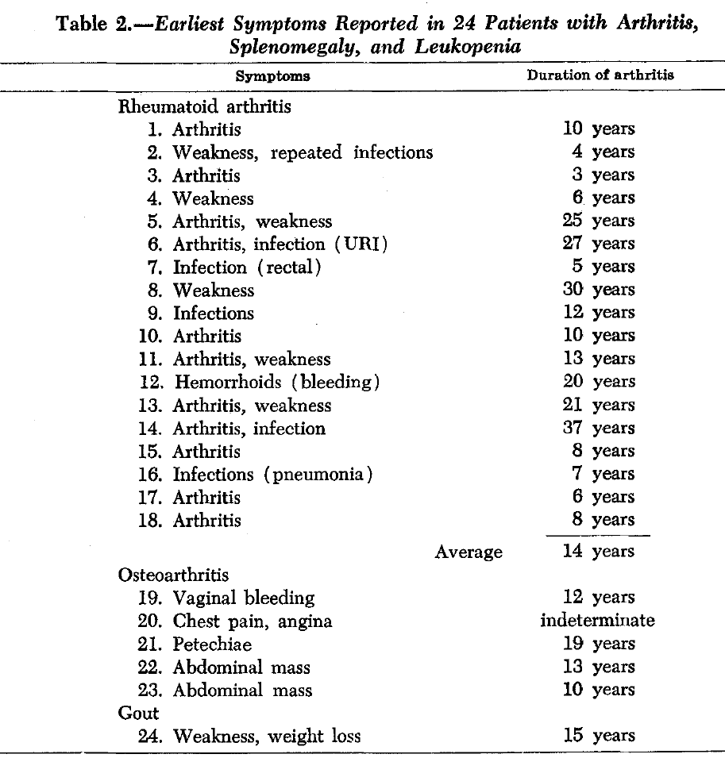

Slide 8
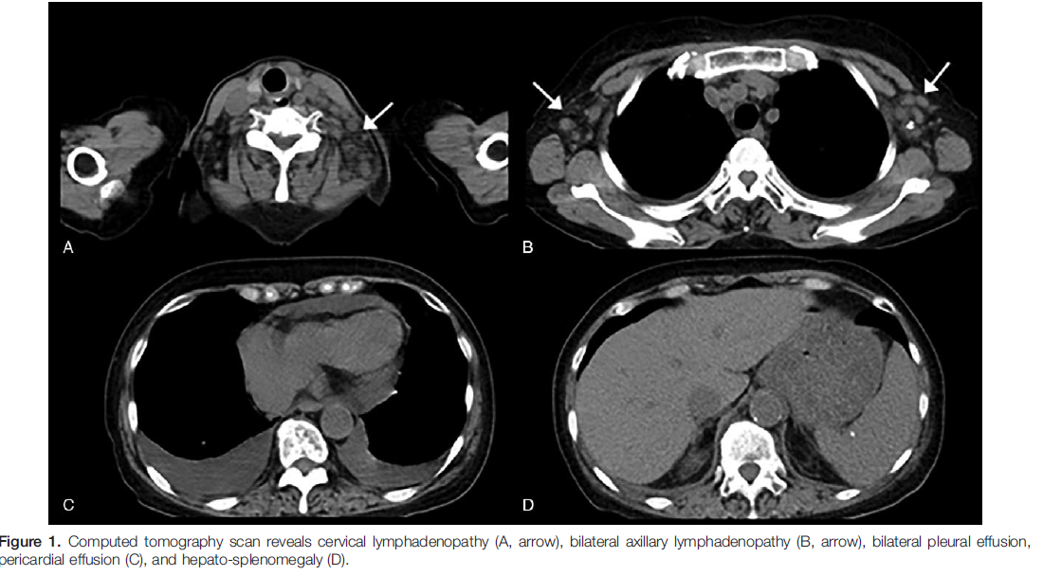

Slide 9
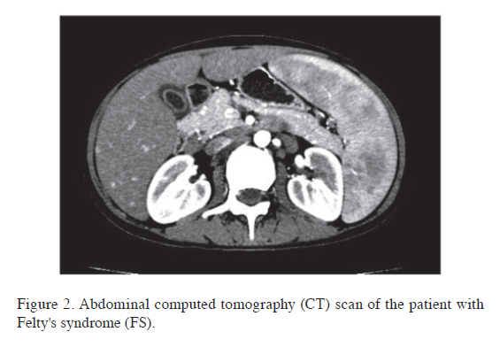

Slide 10
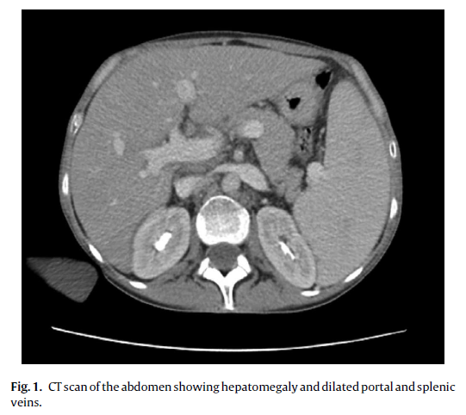

Slide 11
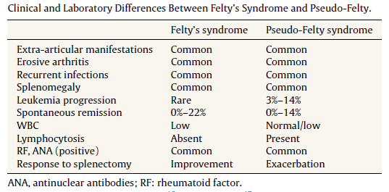

Slide 12
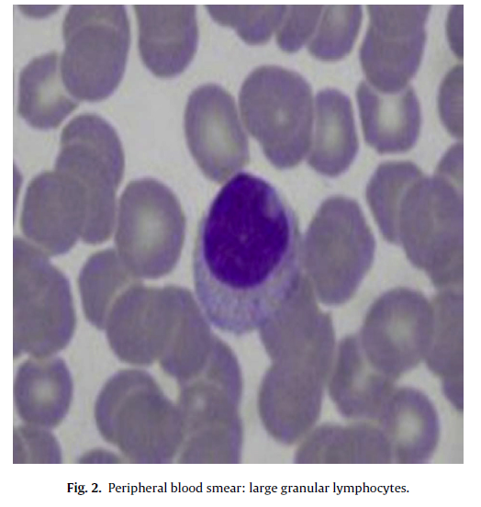

Slide 14
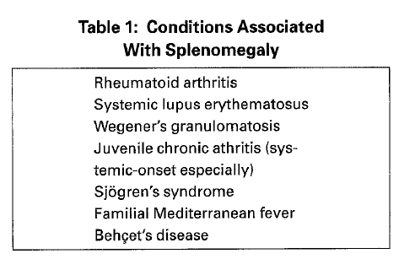

Slide 15
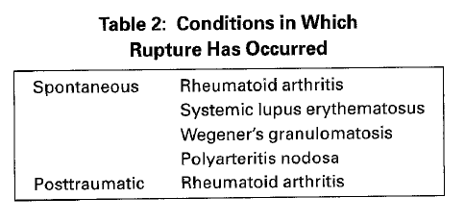

Slide 16
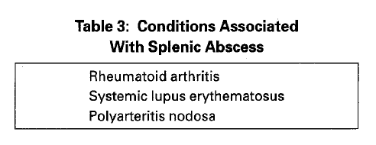

Slide 17
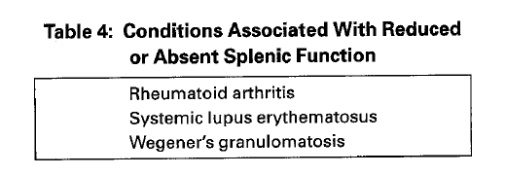

Slide 18
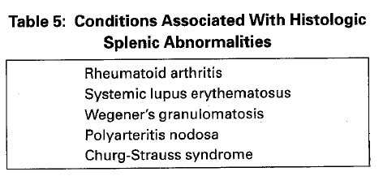

Slide 19
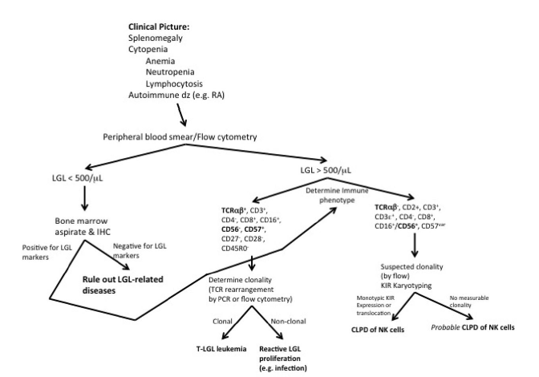

Slide 20
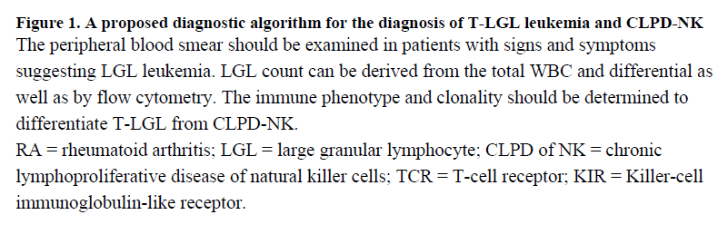

Slide 21
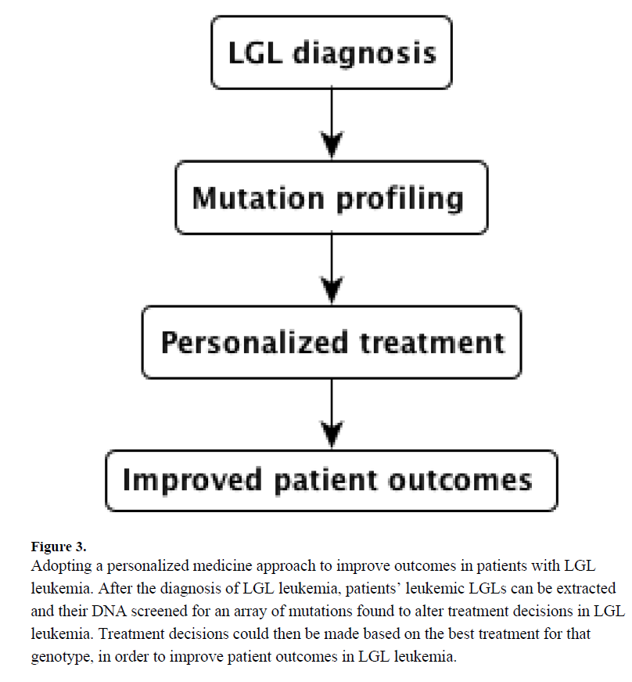

Slide 22
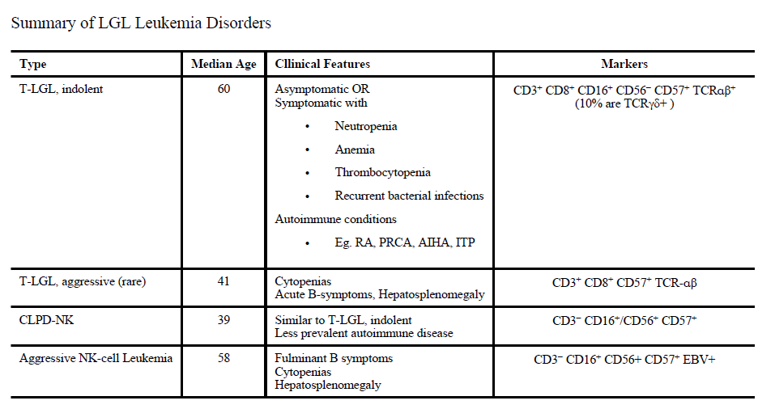

Slide 23
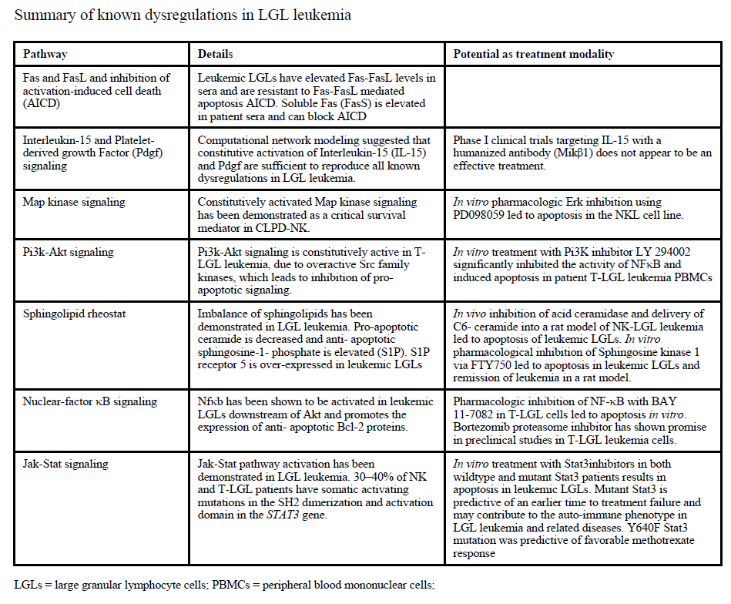

Slide 24
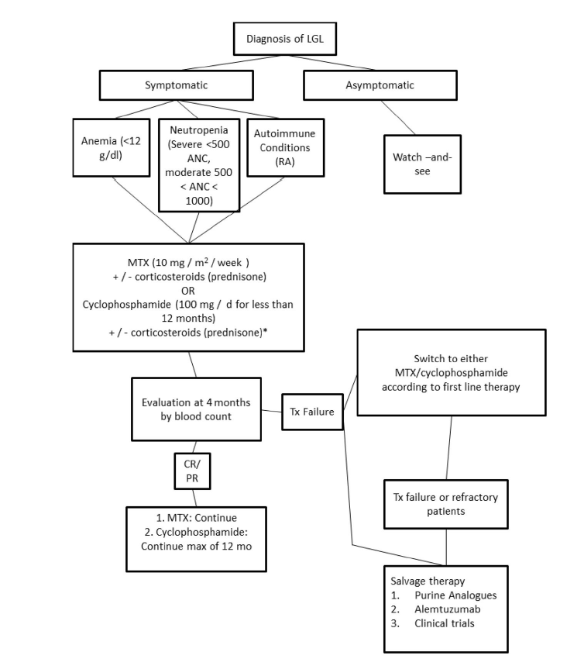

Slide 27
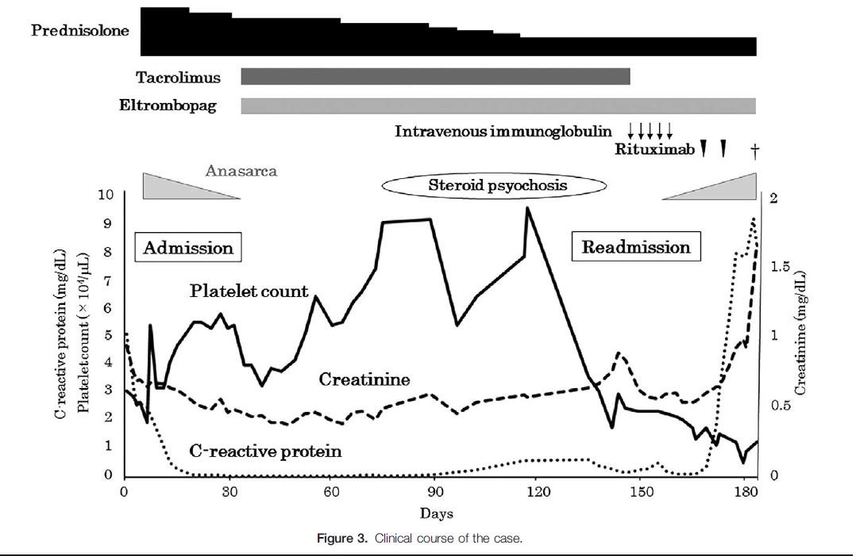

Slide 28
